Slide 1

Causes of Alcoholism
Dean Daley
Harinee [Last Name]
Craig Taflin

Slide 2
Executive Summary: Alcoholism affects people across all 50 states
Problem:
In 2010, 5.4% of adult men reported heavy drinking and 4.5% of adult women reported heavy drinking (2). Heavy drinkers are more likely to binge drink than moderate drinkers (3).
Question:
1.) What is the Definition of Alcoholism?
2.) Who is affected by Alcoholism?
3.) What are the underlying causes of Alcoholism?
Notes:
1.) Harinee will discuss the definition of Alcholism
2.) I will talk about who is affected by this Disease
3.) Dean will then discuss the underlying causes

Slide 3
Definition of Alcohol
a.) Binge Drinking:
-Prevalence (%): Drinks at an occasion / Last 30 days (M- 5+, W- 4+)
-Intensity: Largest Number at an Occasion / Last 30 days
-Frequency: Binge episodes / Last 30 days
b.) Heavy Drinking: Total drinks per week / Weekly within Last 30 days
(M- 14+ W-7+)

Slide 4
Data Collection & Cleansing
1.) CDC U.S. Cancer Statistics Technical Notes - Statistical Methods: Incidence and Death Rates - NPCR – Cancer
2.) Eater.com- Number of people per bar in each state
3.) [income source of data]
(Data Cleaning besides Merging Data- Can I combine within this slide)
*Concatentate and reverse Concatenate columns
*Grouping, Mean , Conditional, Filtering, change data types
Exclude non-Alcohol Data
Break out Age, Sex, data metrics (binge, heavy)
Notes:
Make one big change and then be general for the rest of them

Slide 5
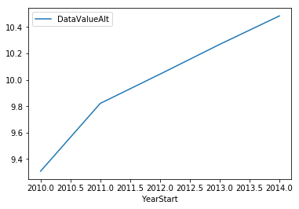
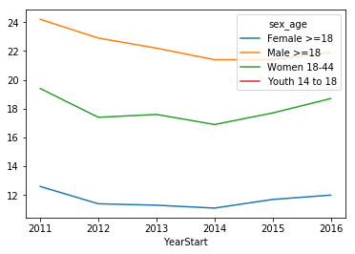
Propensity to Drink Chronic Liver Disease (add overall_age) (add by sex_age)
Notes:
Limitation of Chronic Liver Disease
Limitations of indicator Because alcohol-related disease can have a long latency, changes in behavior or clinical practice affecting population mortality might not be apparent for years. Not all chronic liver disease deaths are alcohol-attributable. However, in 2009, almost 70% of cirrhosis deaths in the United States were alcohol-attributable (5), and the proportion of cirrhosis deaths coded as 100% alcoholattributable has increased dramatically during 1970–2009 among United States adults aged 25–64 years (5)

Slide 6
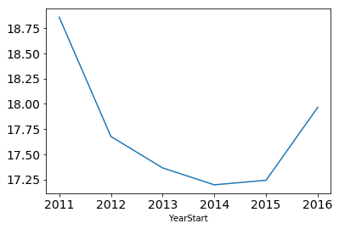
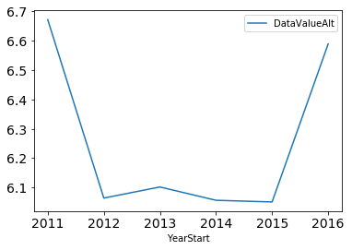
Binge Plot Heavy

Slide 7
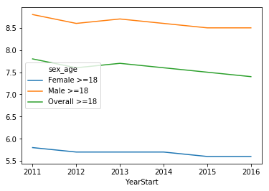
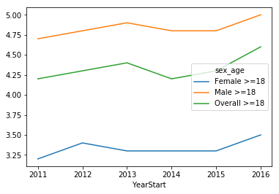
Intensity Frequency

Slide 8
Challenges / Open Questions Remaining

Slide 9
Backup/Alternative Sides

Slide 10
Table of Contents or AGENDA (OPTIONAL)
1.)Executive Summary

